Slide 1
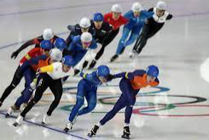
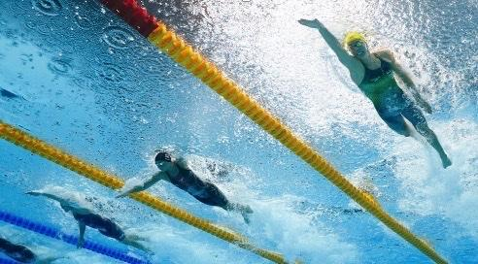
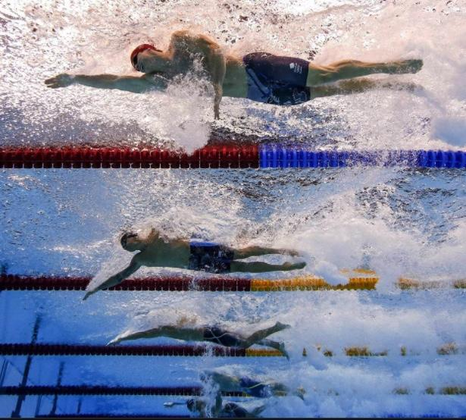
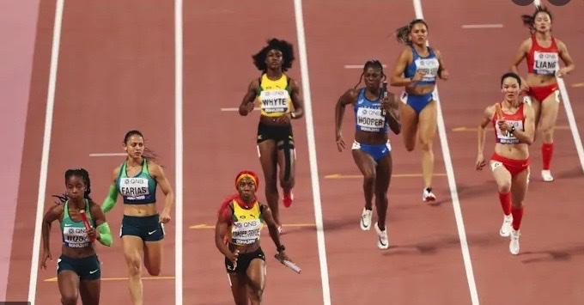
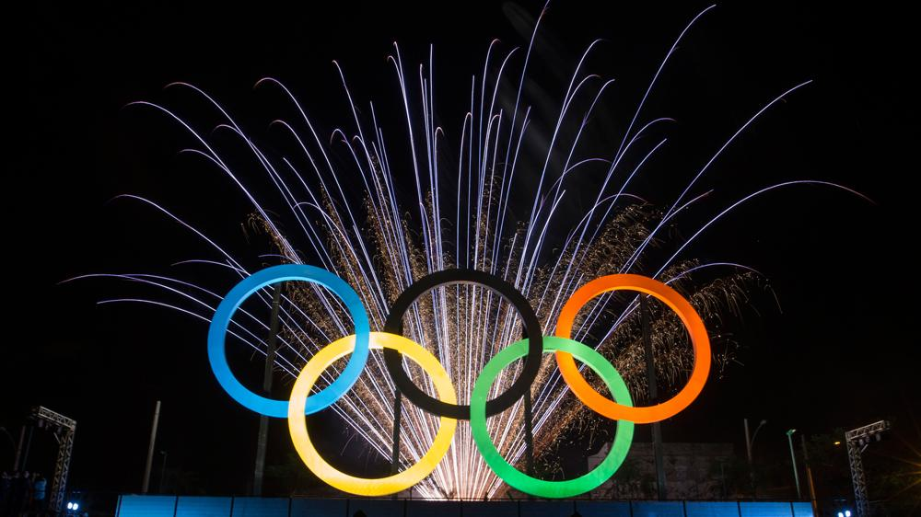
Final Project : Data Wrangling & Husbandry
Women in Olympics
~ A Century of Progress
Objective:
Olympics Data Collection from Kaggle/Web
Clean the scraped data
Tidy the data and resolve data issues
Visual representation of the results
Presenters: Cheryl Allen-Munley Kalaivani Karunakaran Sahitee Ramya Y V N

Slide 2
Goals & Data Analyses
Olympic Sports with Primary Focus in Skating, Swimming, and Track & Field.
Growth in the number of sports and events in Summer & Winter Games – Kaggle Data range from 1896 to 2016.
Nations participating in Olympics to identify gender distribution - Kaggle Data.
Medals by countries for one summer & winter sport - Web Scraping.
Male vs Female participation over time in Olympics - Kaggle Data.
Male vs Female Olympic medal counts for all nations - Web Scraping.
Countries hosted Olympics over years - Web Scraping.
Historic Male vs Female performance in timed sports such as swimming, skating, and track & field -Web Scraping Data.
Correlation between competitors performance (time) vs. height & weight. - Kaggle/Web Data.
Notes:
c

Slide 3
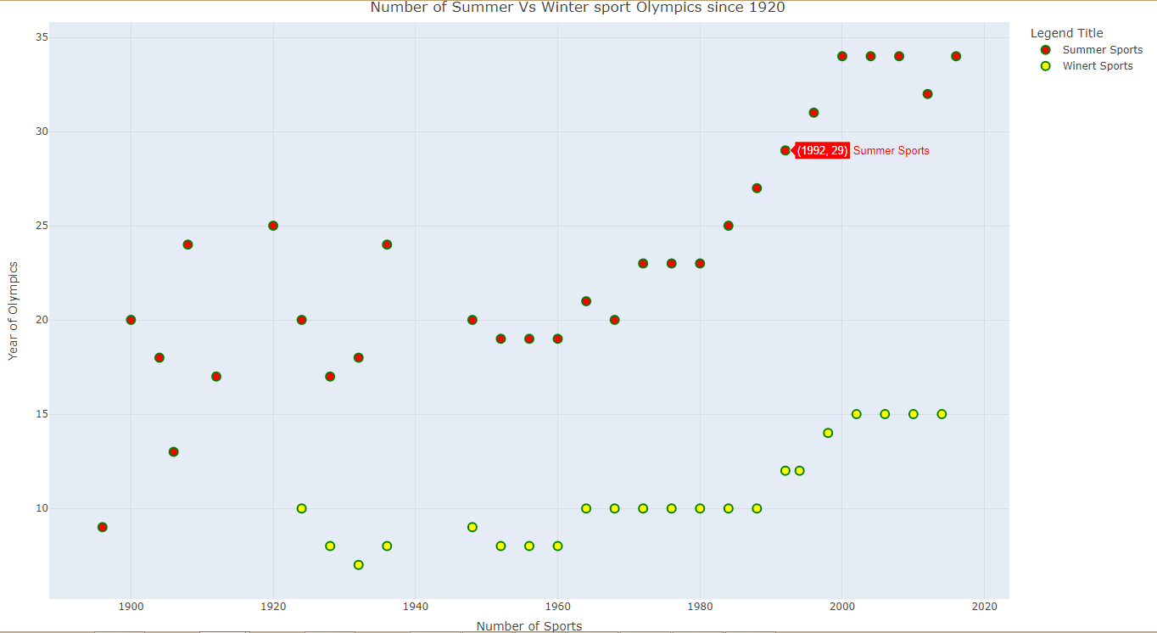
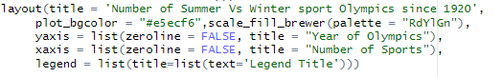
Growth in the Number of Sports

Slide 4
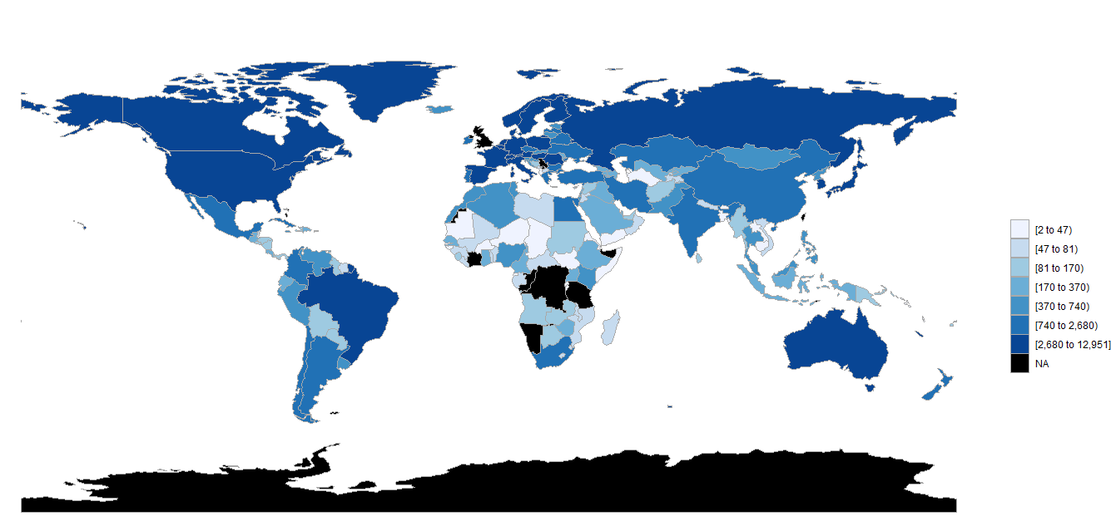
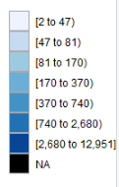
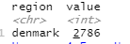
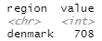
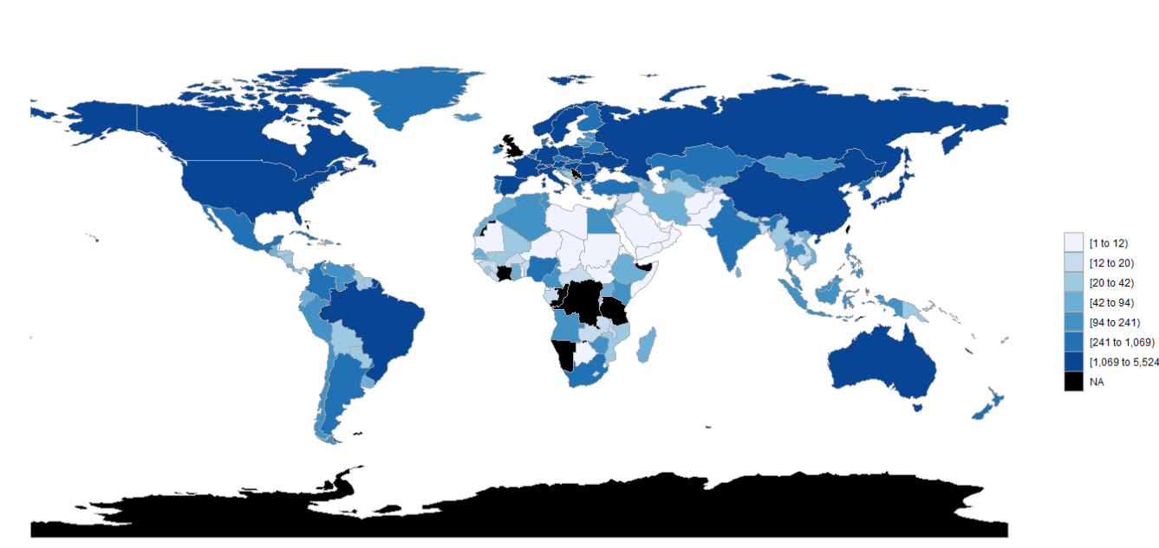
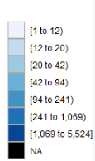
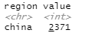
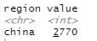
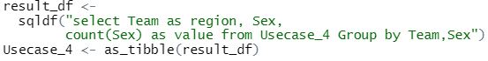
Gender Participation
Men Participation
Men
Women
Women Participation
Men
Women

Slide 5
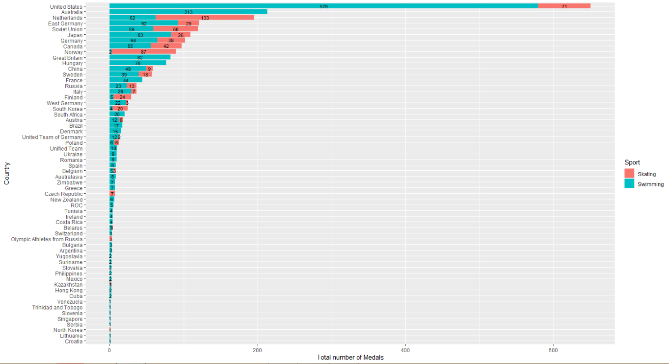
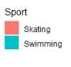
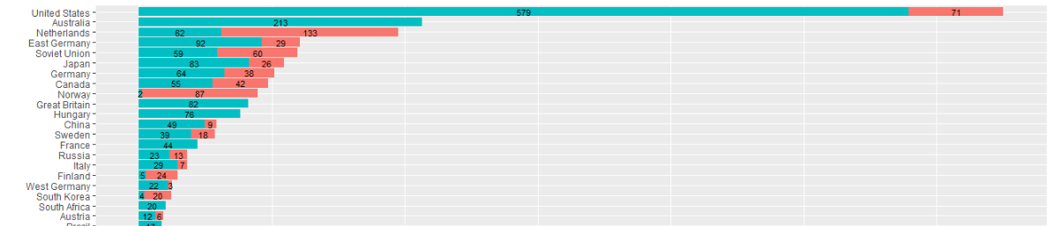
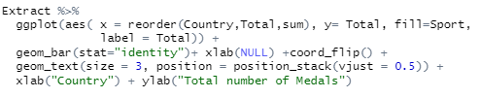
Medal Summary by Nations

Slide 6
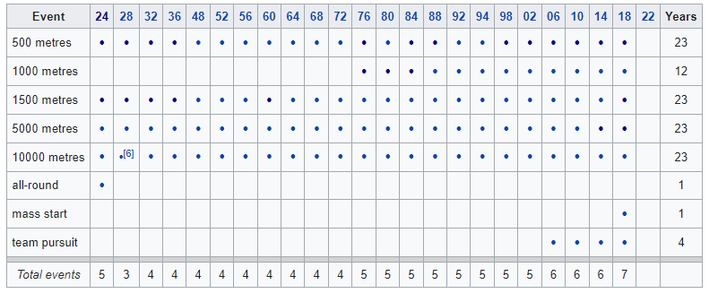
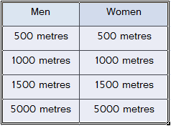
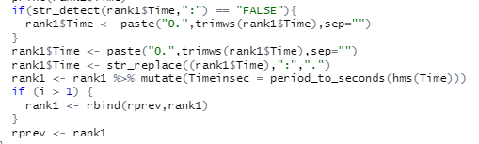
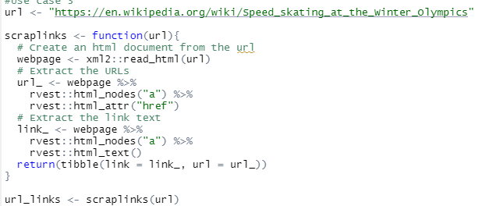
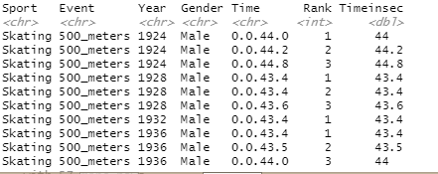
Data Web Scraping - Skating

Slide 7
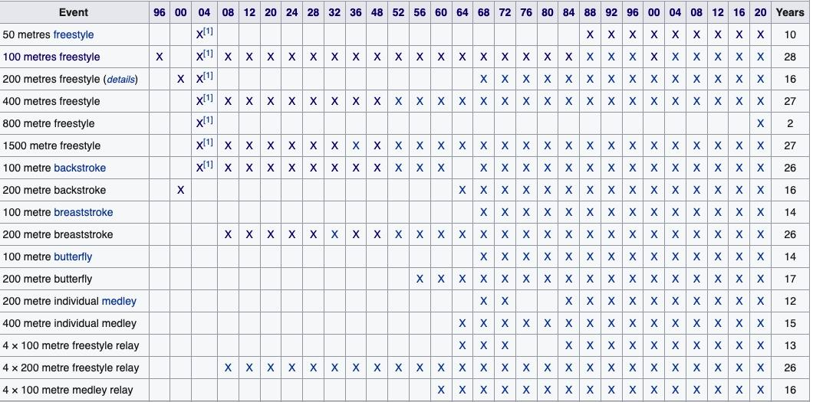
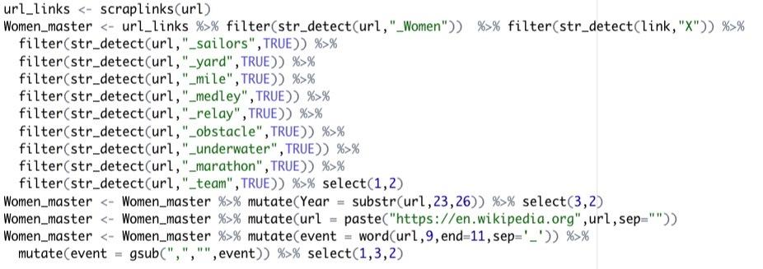
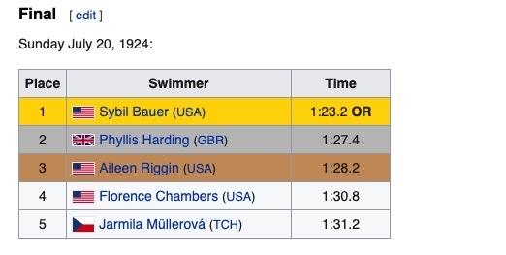
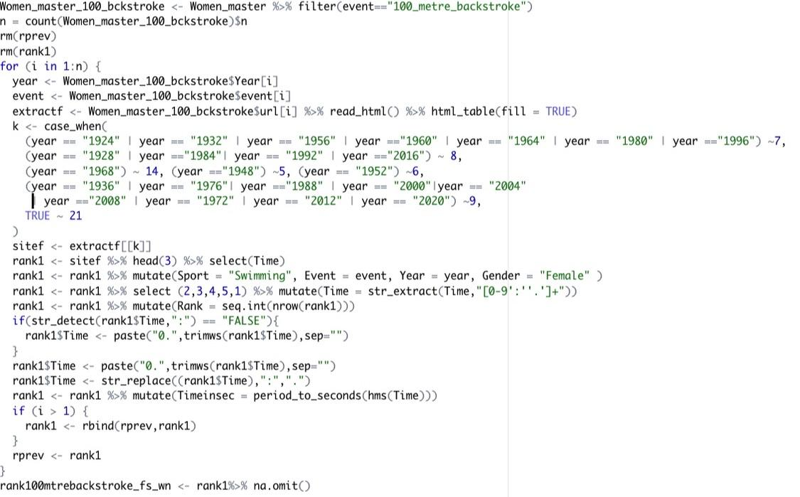
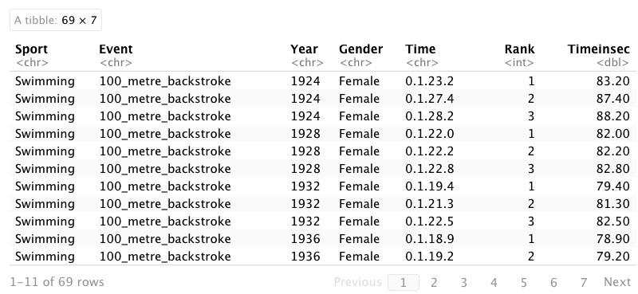
Data Web Scraping - Swimming
Men / Women Swimming Events
50-meter freestyle
100-meter freestyle
200-meter freestyle
400-metre freestyle
100-metre backstroke
100-metre breaststroke
100-metre butterfly

Slide 8
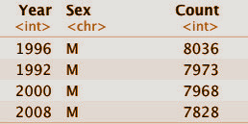
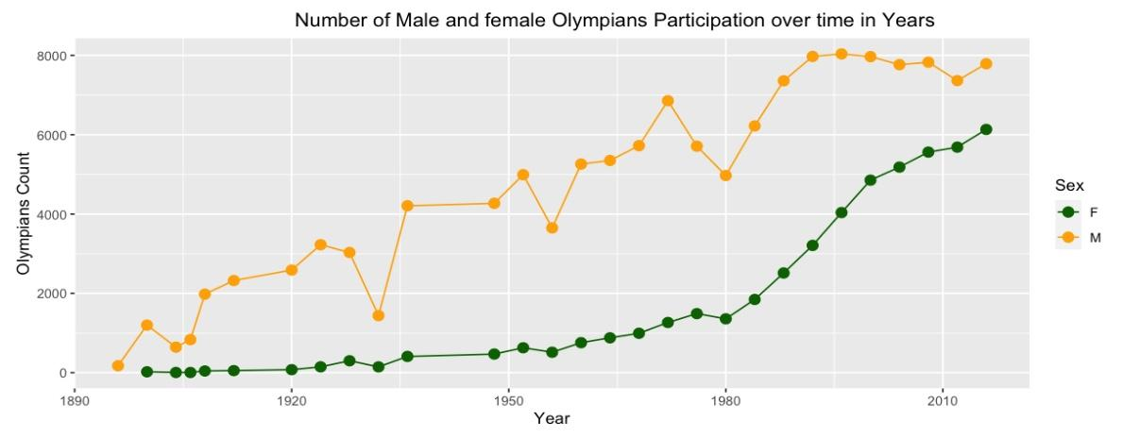
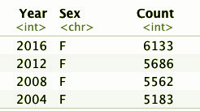
Male vs Female Participation Over Time
Data Tidy Focus : From Kaggle
Focus on Olympics summer and winter Events, data at the sport level.
Art competitions were not included.
Aligned Summer and Winter Olympics held year.
Observations :
There is a clear increase in the inclusion of the female after 1950 in competitions, however, the male participation is erratic.
Zero Female Participation in 7 games. ex: Jeu De Paume,Lacrosse,Military Ski Patrol,Polo,Racquets,Roque,Tug-Of-War
Zero Male participation in Rhythmic Gymnastics.

Slide 9
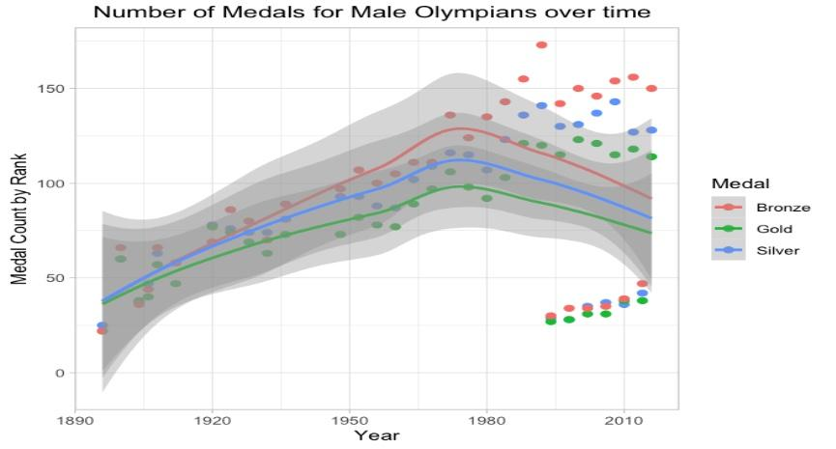
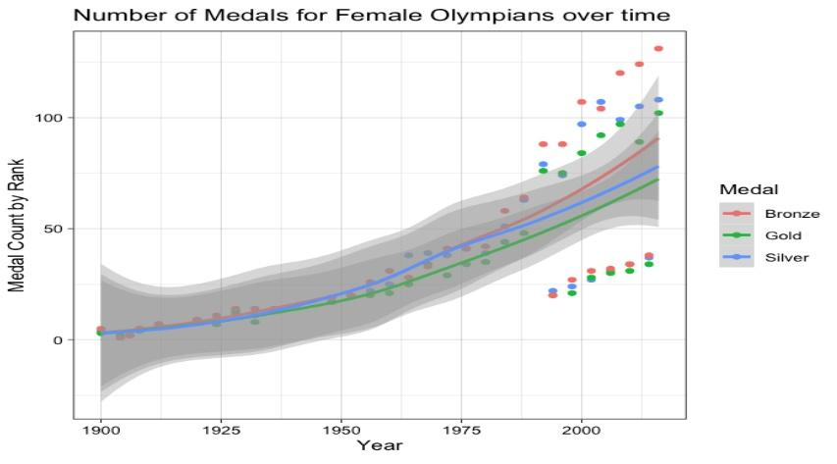
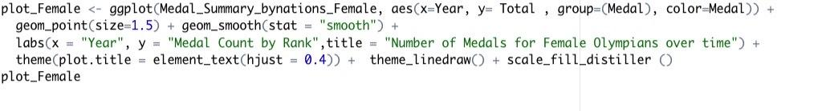
Male vs. Female Olympic Medal Counts
​​
Data Tidy Focus : From Kaggle Data → Focus on Olympics summer and winter sports Medal Summary by Rank and by Year for all Nations.
Observations:
Female participations started increasing after 1976 with 12 teams bringing in at least 25% women.
In 1992, the winter sports are separated which skews the trends for both.
Medal Dominations by country:
American women : 2016
East German & Soviet Women : 1976
Germany women : 1936

Slide 10
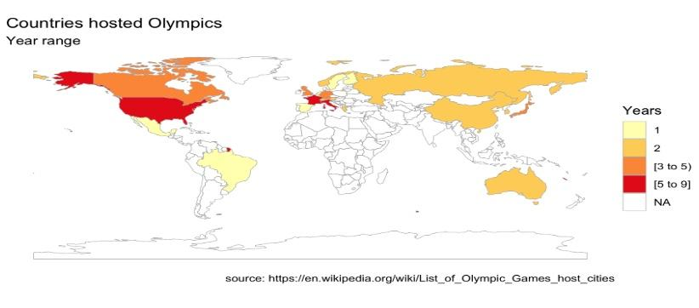
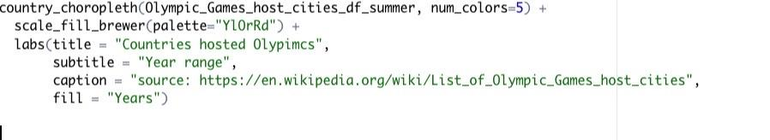
Locations Hosted
Data Tidy Focus :
Data collected from web for all years.
scraped the data and matched the countries with Choropleth countries for plotting.
Observations:
The United States has hosted a total of 9 Olympic Games, more than any other country.
France hosted 6 and Japan with 4..
The United Kingdom, Canada, Italy and Germany have each hosted 3 Games.
Rank | Country | Summer Olympics | Winter Olympics | Total
1 | United States | 5 (1904, 1932, 1984, 1996, 2028) | 4 (1932, 1960, 1980, 2002) | 9
2 | France | 3 (1900, 1924, 2024) | 3 (1924, 1968, 1992) | 6

Slide 11
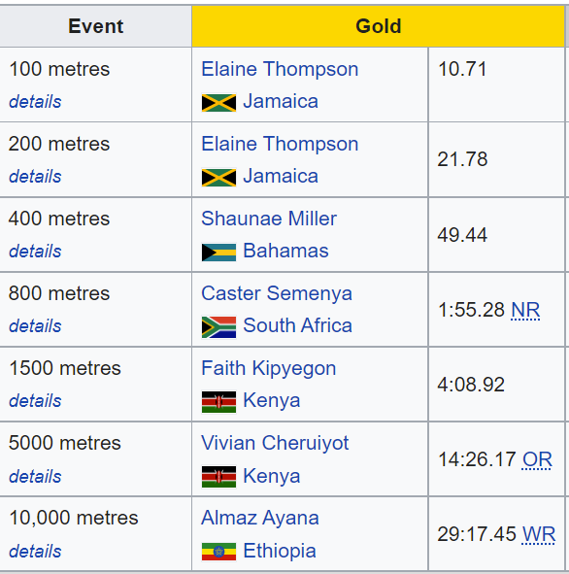
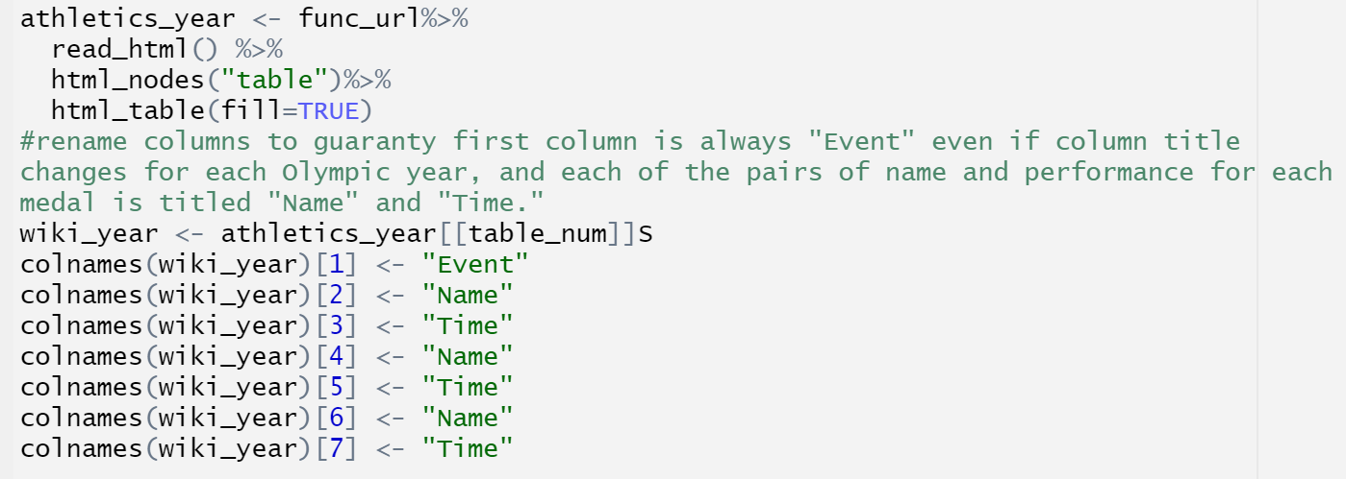
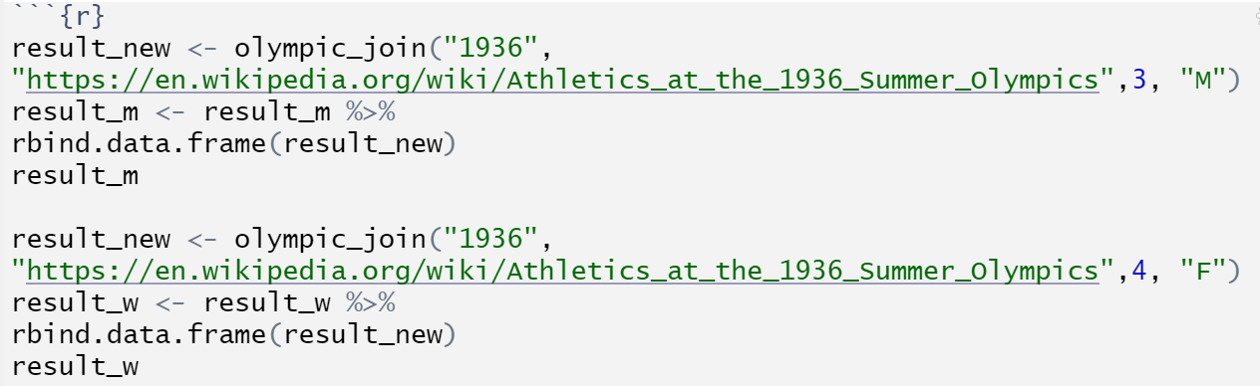
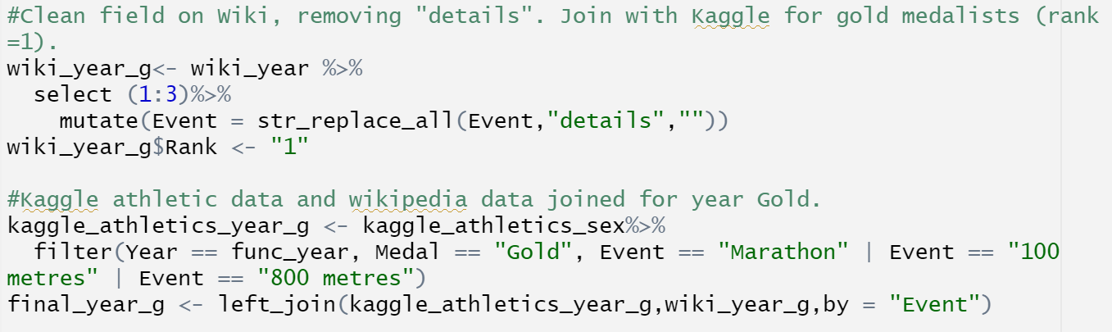
Male vs. Female: Wiki/Kaggle Join

Slide 12
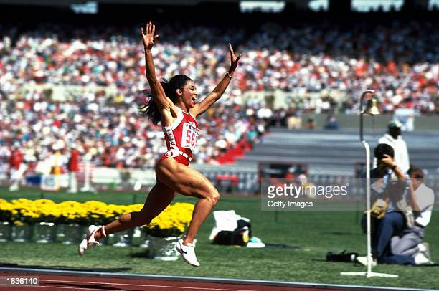
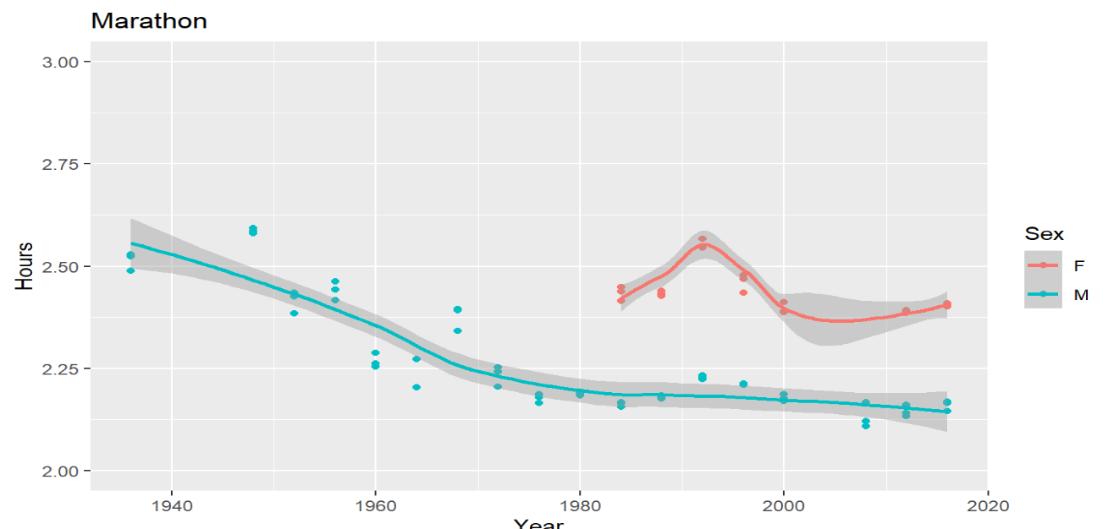
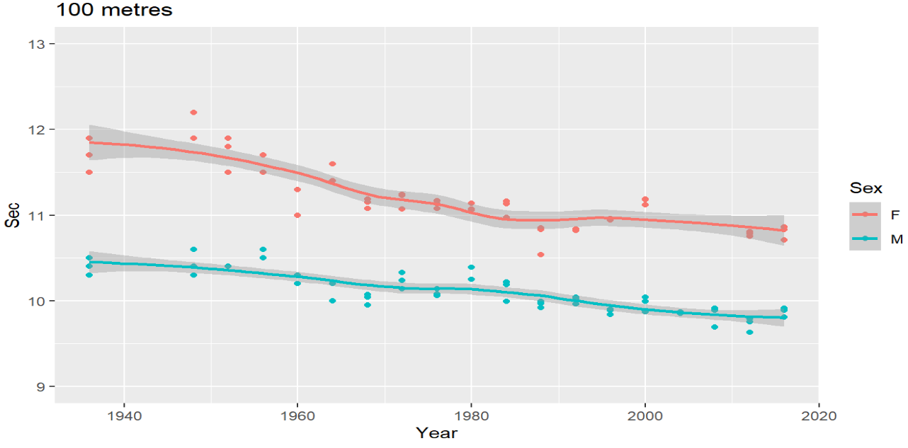
Male vs. Female: Track & Field
Visuals provide clear communication:
Trends: initially both men and women’s performance improve with time, but then plateau in the 1980’s
Anomalies: poor performance in 1992 women’s Marathon, Unmatched 100 yard dash by “Flo Jo” Joyner in 1976.
Catch errors. 1988 women miscoded as men

Slide 13
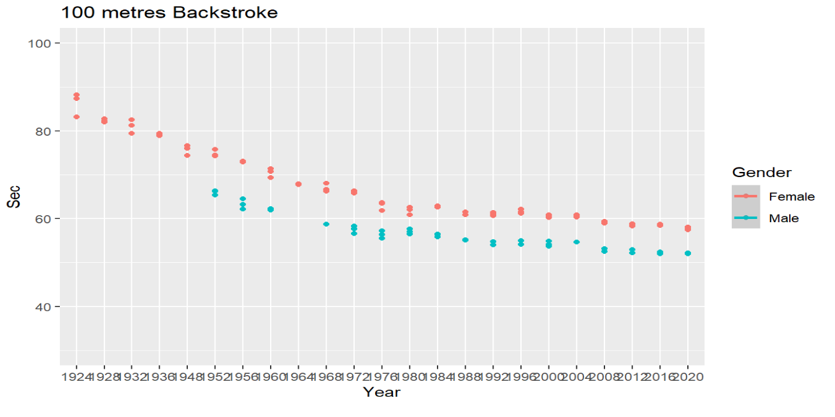
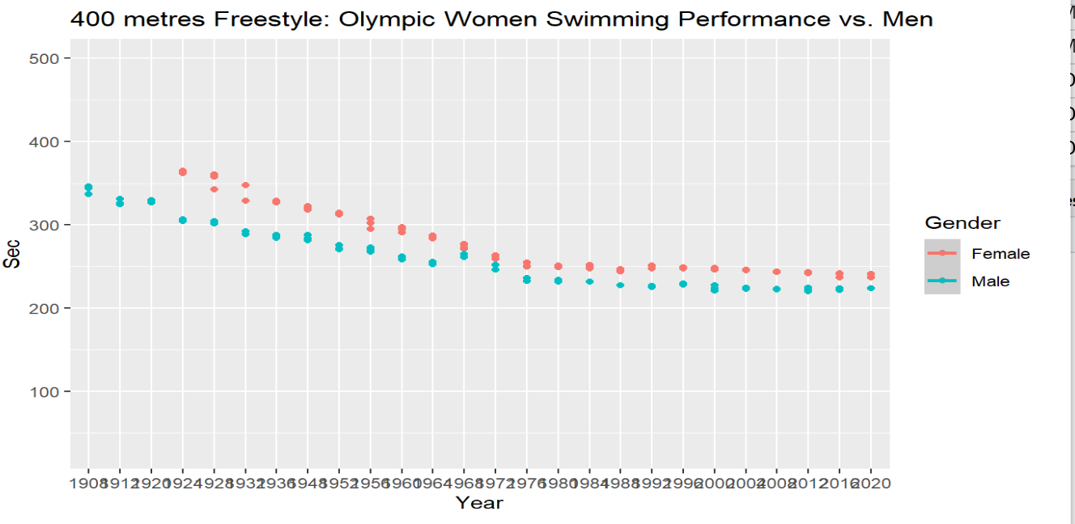
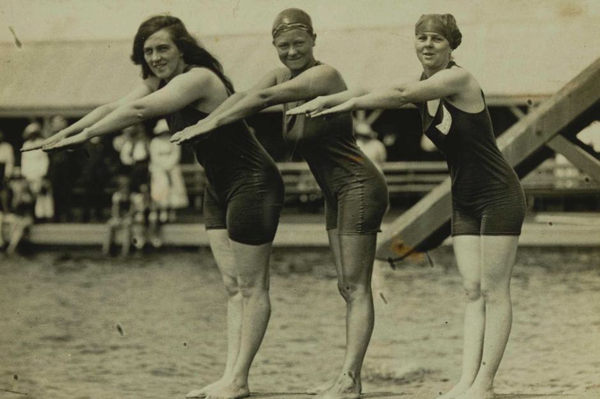
Male vs. Female: Swimming

Slide 14
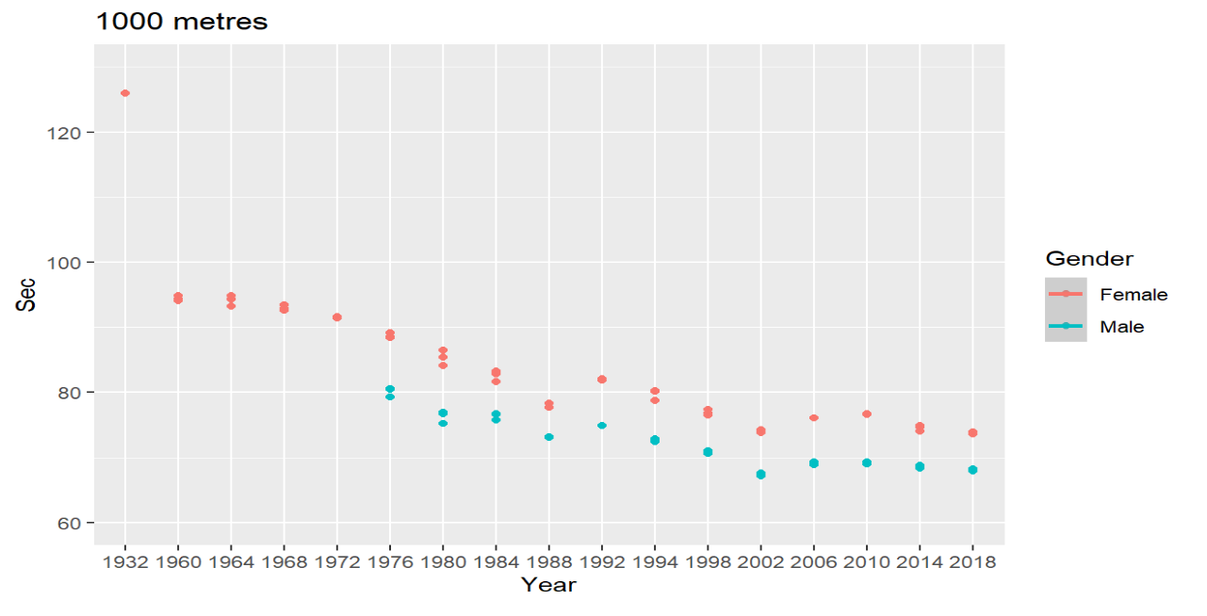
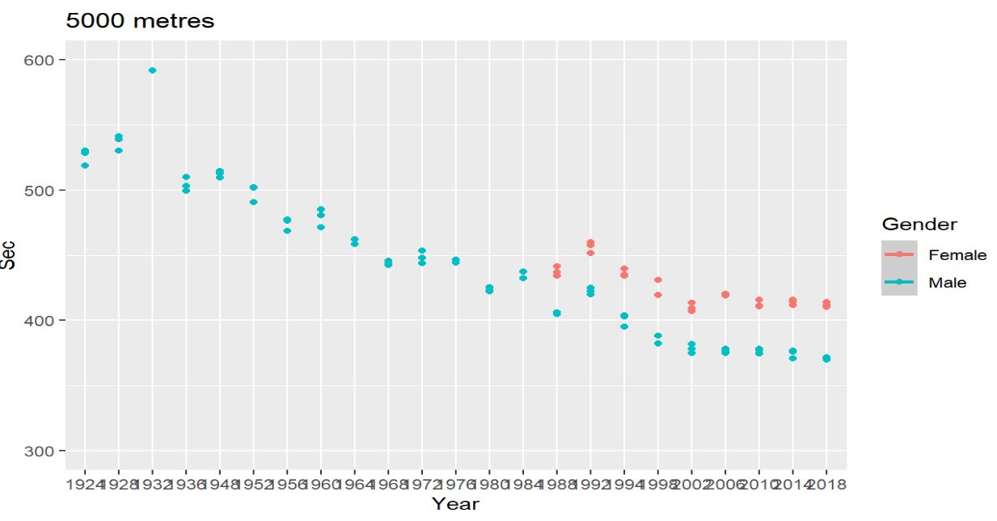

Male vs. Female: Speed Skating

Slide 15



Correlation: Performance vs. : Height & Weight

Slide 16

Conclusions:
Modern Olympics began in 1896. Initially, prejudice limited women’s participation, especially in endurance events, e.g., there is no women’s Marathon until 1984.
Cultural norms can constrain choice of events, e.g., Muslim women can compete in equestrian sports and fencing, but not in swimming, due to the uniform.
Data wrangling allowed us collect, merge and clean data to answer some of our questions: How does women’s performance compare against men? Does national presence affect women participation.
With more time, the impacts we would have like to research: women’s suffrage, drug testing, genetic testing, eliminating amateur requirements, Title 9 (US mandate for funding of women’s sports).
Lessons Learned :
The selection of the key values for merging data sets is critical . Much time was lost attempting to merge the Kaggle and Wikipedia site using Athletes names (multiple middle names, foreign symbols, appended country names) when the ultimate choice of event name required much less cleaning.
We have spent considerable time to narrow down the precise web links for data collection.
We automated code to perform repeated actions to scrape the web data, using conditional statement, loops, and R functions.
We used majority of libraries/packages learnt in the course and applied flavors of functions & plots.
Website/ Data References:
https://en.wikipedia.org/wiki/List_of_Olympic_Games_host_cities
https://en.wikipedia.org/wiki/Swimming_at_the_Summer_Olympics
https://en.wikipedia.org/wiki/Swimming_at_the_1896_Summer_Olympics
https://en.wikipedia.org/wiki/Speed_skating_at_the_Winter_Olympics
https://en.wikipedia.org/wiki/Athletics_at_the_Summer_Olympics
www.Kaggle.com

